Slide 1



Ksenia Komarova
The Fritz Haber Center for Molecular Dynamics
The Hebrew University of Jerusalem
Surprisal of a quantum state:
Dynamics, compact representation and coherence effects
VISTA Seminars
November 19 2020

Slide 2
Why surprisal?
- Effective computational method*
High degree of the data compaction
Novel insights
*Extensively applied in different fields:
-> to analyse the energy disposal in reaction dynamics
-> in system biology to characterize
dominant behavior patterns
R. B. Bernstein and R. D. Levine, "Entropy and Chemical Change.
I. Characterization of Product (and Reactant) Energy Distributions in Reactive Molecular Collisions: Information and Entropy Deficiency," J. Chem. Phys. 57, 434-449 (1972)
Zadran S et al. Surprisal analysis characterizes the free energy time course of cancer cells undergoing epithelial-to-mesenchymal transition. PNAS, 111:13235–13240 (2014)
Experimental HD state distributions
measured for H+D₂ collision
1

Slide 3
Ultrafast non-radiative relaxation
Dynamics in excited electronic states of pyrazine
S₂
S₁
*
*Real-time resolved pump-probe
photoelectron spectroscopy experiment:
Y.-I. Suzuki et al, J Chem Phys, 2010, 132, 174302
2

Slide 4
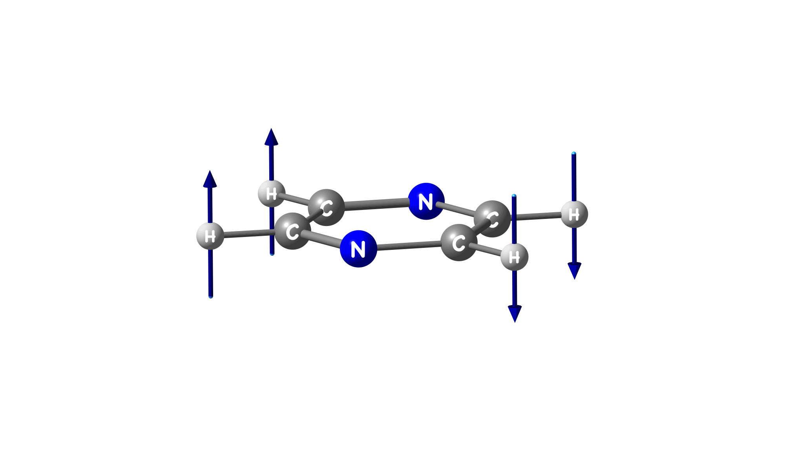
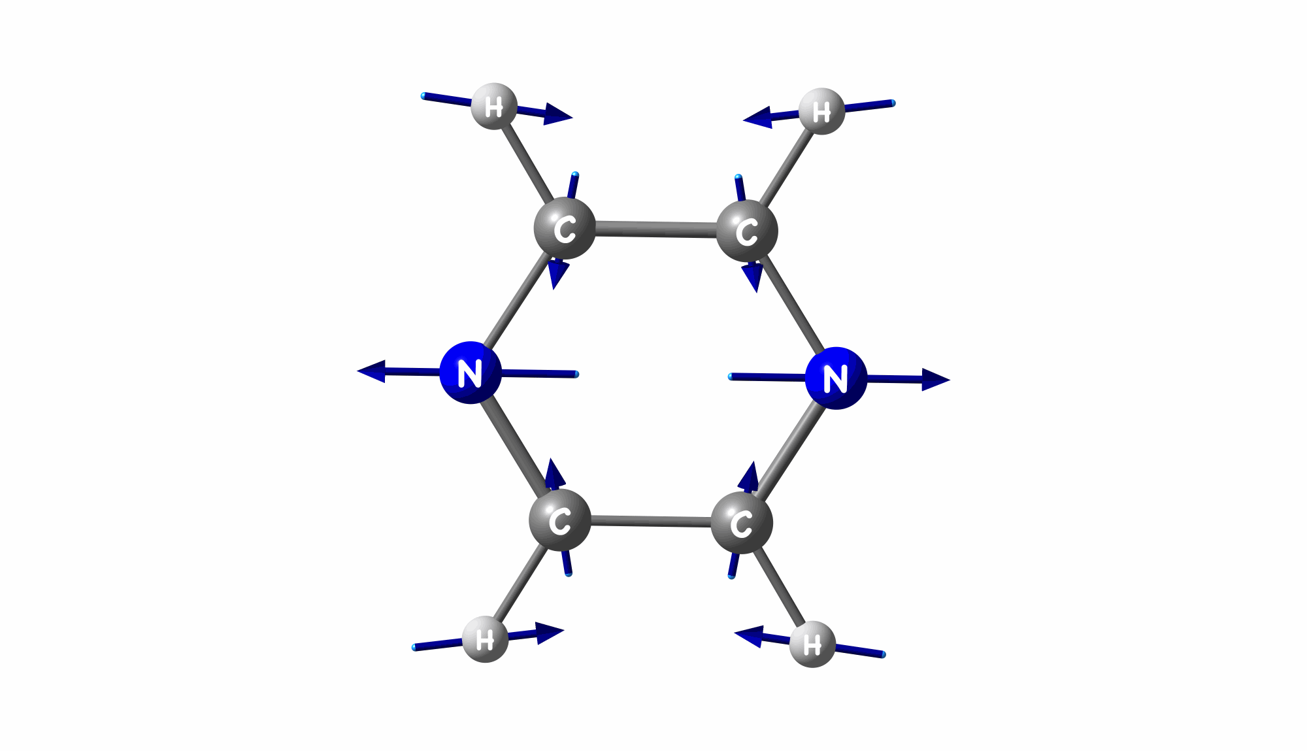
Ultrafast non-radiative relaxation
Dynamics in excited electronic states of pyrazine
Coupling mode Q₁*
Tuning mode Q₂
->Diabatic coupling between S₂ and S₁: κQ₁
-> Nuclear motion towards CI
MCTDH: 24-modes diabatic picture for the dynamics**
* R. Schneider, W. Domcke, Chem Phys Lett, 1988, 150, 235
** I. Burghardt et al, Phys. Scr. 2006, 73, C42
2

Slide 5

Non-adiabatic quantum dynamics on multiple electronic states
Challenge
Can we have a compact representation
for the quantum treatment of the dynamics?
’Quantum’ features
Branching of the wave packets
in configurational space
Coherence effects on the
vibrational and/or electronic dynamics
Electronic energy redistribution
for the coherent dynamics on multiple electronic states
Let us try to address the problem
from a fresh perspective!
3

Slide 6
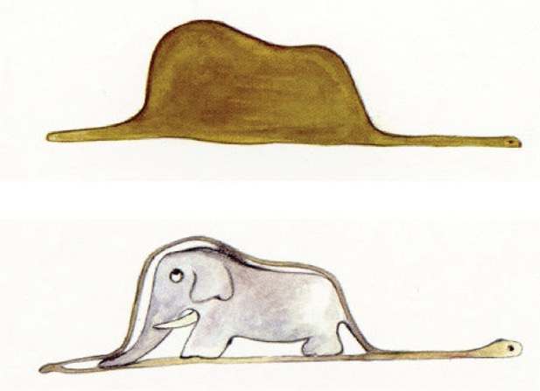

Algebraic approach in chemical dynamics
The state of the system, the density matrix:
- constraints*
*More examples of different algebras:
Dynamical symmetry, C.E. Wulfman (2010)
4

Slide 7
Algebraic approach in chemical dynamics
The state of the system, the density matrix:
- constraints*
Time evolution of the density via the evolution of the constraints
Y. Alhassid, R.D. Levine, J Chem Phys, 1977, 67, 4321
5

Slide 8

Density and its surprisal
Surprisal
When time evolution of the constraints is closed:
Information about the time evolution is compressed to
just a vector λ(t)
Y. Alhassid, R.D. Levine, J Chem Phys, 1977, 67, 4321
6

Slide 9

Surprisal of a quantum state in the general case
In a given finite basis representation:
k
Equation of motion for the surprisal:
Compact representation
via dominant constraints:
Straightforward transformation between them via the spectral decomposition:
K. Komarova, F. Remacle, R.D. Levine, J Chem Phys, 2020, accepted.
ChemRxiv: https://doi.org/10.26434/chemrxiv.12981857.v1
7

Slide 10
Dominant constraints in the vibrational basis
8

Slide 11
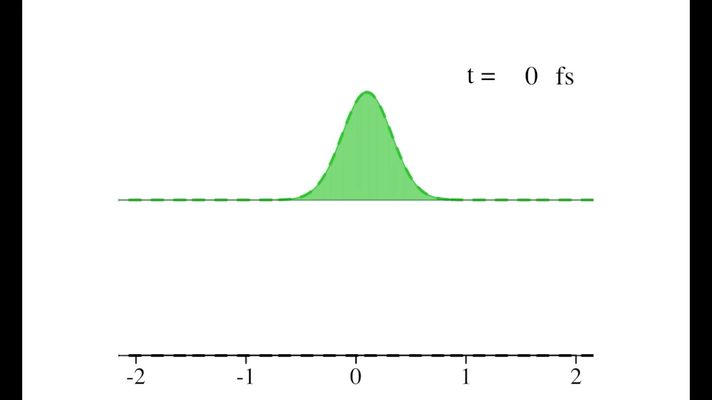
Compact representation of the non-adiabatic transfer in pyrazine
Population in S₂
Population in S₁
Coupling mode
9

Slide 12
Dominant constraints
 | Gelfand basis | Dominant constraints
Small initial shift | 400 | 16
Large initial shift | 1600 | 24
10

Slide 13

Dominant constraints
 | Gelfand basis | Dominant constraints
Small initial shift | 400 | 16
Large initial shift | 1600 | 24
Constraints responsible for the
bi-gaussian shape of the S₁ wave packet
10

Slide 14
Surprisal based quantum dynamics
NxN
NxN

Slide 15



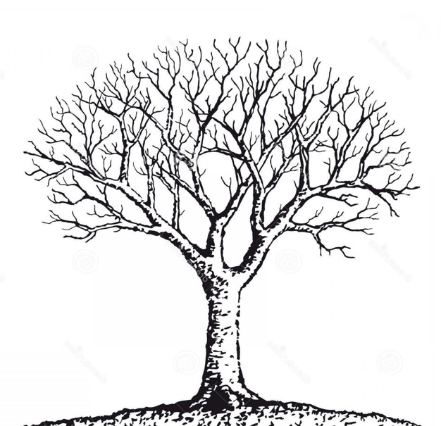

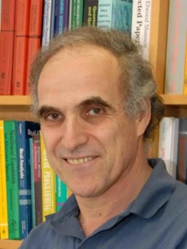
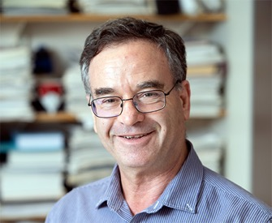
Acknowledgements
Prof. Raphael Levine
Prof. F. Remacle
Hebrew University
University of Liege
Prof. Y. Alhassid
Prof. N. Tishby
Prof. S. Kais
Yale University
Hebrew University
Purdue University

Slide 16
Thank you for your attention!

Slide 18
Dominant constraints in the vibrational basis
Set of 16 time-independent constraints for the direct product Hilbert space of electronic and nuclear degrees of freedom
9

Slide 19
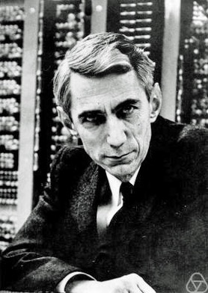
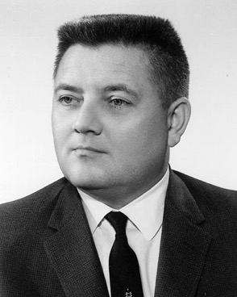
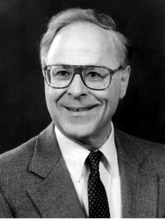
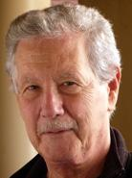
Surprisal analysis and maximal entropy formalism
E.C. Kemble
A. Katz
E.H. Wichman
J.L. Kinsey
And many other..
1948
1957
1972
Information Theory
Information Theory and
Statistical
Mechanics
Information Theory
and
Chemical
Change
Claude Shannon
Edwin Jaynes
Richard Bernstein & Raphael Levine

Slide 20
Density and its surprisal
Surprisal
Evolution of the surprisal

